Slide 1


Introduction to
Robotic Process Automation
Expense Reimbursement Automation
220701068
Divya Sundhari S M
BE CSE B
Mrs. Jinu Sophia
Assistant Professor (SG)

Slide 2
Abstract
Expense reimbursement automation project aims to develop an automated expense reimbursement system using UiPath, enabling seamless handling of receipts, saving the receipts information, and reviewing it by the manager, and notifying the employee about the completion of transaction by the Finance department.
UiPath ensures employees receive timely notifications about the status of their reimbursements. By leveraging robotic process automation (RPA) through UiPath, this project ensures transparency, accuracy, and efficiency across all stages of expense management.

Slide 3
Need for the Proposed System
Delays in Processing
Manual handling of expense reimbursements often leads to significant delays. Employees must wait for their receipts to be reviewed and approved, and this process can take days or even weeks, causing frustration and dissatisfaction.
Mismanagement of Receipts
Physical or digital receipts are prone to being misplaced or mishandled during manual processing. This mismanagement can result in incomplete records, which further delays the reimbursement process and may even lead to disputes.
Risk of Human Error
Manual data entry and calculations are susceptible to errors, such as incorrect amounts or duplicate entries. These errors can cause financial discrepancies and impact the organization’s financial records.
Employee Dissatisfaction
The inefficiency and lack of transparency in manual processes can lead to employee frustration. Delayed reimbursements and unclear communication erode trust and morale, impacting overall employee satisfaction.
Scalability Challenges
As organizations grow, the volume of expense claims increases, making manual processes unmanageable and prone to bottlenecks.

Slide 4
Advantages of the Proposed System
The proposed automated system addresses these issues by:
Minimizing Manual Effort: Automating data extraction from receipts and updating a centralized Excel sheet reduces the time and effort required for manual data entry.
Improving Accuracy: Automation eliminates human errors in data processing, ensuring accurate and consistent record-keeping.
Streamlining Communication: Automated notifications ensure timely updates to managers, finance teams, and employees, reducing communication gaps and enabling a smooth workflow.
Enhancing Transparency: The centralized Excel sheet, accessible to all stakeholders, provides a clear view of each receipt's status, from submission to reimbursement.
Increasing Speed: By automating key steps like data extraction, notifications, and status updates, the process is significantly faster compared to manual workflows.
Scalability: The system can handle a high volume of receipts efficiently, making it suitable for organizations of varying sizes.
Employee Satisfaction: Quick and transparent reimbursement processing fosters trust and improves employee morale.

Slide 5
Main Objective
The main objective of the expense reimbursement process is to efficiently and accurately reimburse employees for legitimate business-related expenses incurred during their job duties, while ensuring compliance with company policies and budgetary constraints.
The process aims to streamline the submission, approval, and payment workflows, reduce administrative overhead, minimize errors, and enhance transparency in financial transactions. By automating and standardizing the process, organizations can achieve faster processing times, improve employee satisfaction, and maintain financial integrity through accurate record-keeping and compliance with tax and audit regulations.

Slide 6
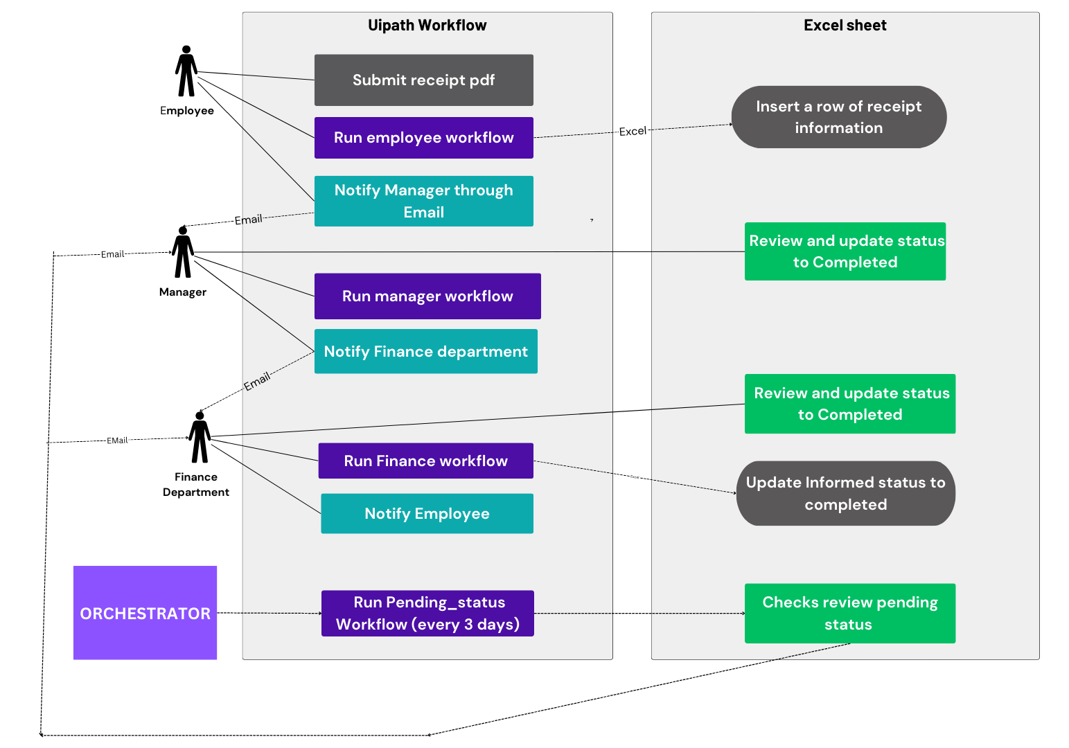
Architecture

Slide 7
System Requirements
Hardware Requirements: A system with at least 4GB of RAM, a dual-core processor, and 2GB of available storage for running the UiPath Studio and associated applications.
Software Requirements: UiPath Studio, Microsoft Excel, SMTP server configuration, and .NET Framework.
Other Requirements: An active internet connection for email and cloud-based integrations, and the necessary access rights to the Excel file and email accounts.

Slide 8
Functional Description
Employee wokflow:
The workflow starts by using the Read PDF Text activity to extract text from the PDF document containing the expense report.
Regular expressions are then applied with the Matches activity to find specific patterns like dates and totals.
The total reimbursement value is extracted by locating the "Total :" keyword and using IndexOf and Substring methods to capture the amount.
An Input Dialog activity prompts the user to enter additional details, such as the employee's name.
The Build DataTable activity creates a structured table to store the extracted data, and the Add Data Row activity adds a new row with this information.
The Excel Application Scope activity opens or creates an Excel file, and the Append Range activity appends the data to the file.
Finally, the Send SMTP Mail Message activity sends an email notification with the relevant reimbursement details to the employee. This automated process efficiently handles the expense reimbursement workflow from data extraction to communication.

Slide 9
Functional Description
MANAGER WORKFLOW:
In the manager workflow, the process begins by using the Excel Application Scope activity to open an Excel file containing employee transaction details. Within the scope, the Read Range activity reads the entire data from the relevant sheet into a DataTable variable.
The workflow then iterates through each row of the DataTable using the For Each Row in DataTable activity.
For each row, an If condition is applied to check if the "Review status" column equals "completed" and the "Transaction status" column equals "pending", both in lowercase and trimmed formats to ensure accurate comparison.
If both conditions are met, the workflow can trigger specific actions in the Then block, such as notifying the manager or updating the status of the transaction, ensuring that pending transactions with completed reviews are appropriately flagged for further action.
Finally, the Send SMTP Mail Message activity sends Finance department notification with the relevant reimbursement details. This automated process efficiently handles the expense reimbursement workflow from data extraction to communication.

Slide 10
Functional Description
Finance department workflow:
The workflow begins by using the Excel Application Scope activity to open an Excel file containing employee transaction details.
Inside the scope, the Read Range activity reads the data from the sheet into a Data Table .
For Each Row in Data Table activity. For each row, an If condition checks whether the "Review status" column is "completed" and the "Transaction status" column is "pending" (both converted to lowercase and trimmed for accuracy).
If both conditions are satisfied, the Send SMTP Mail Message activity sends an email to the employee, notifying them about the completion of their review and the pending status of their transaction.
This ensures that employees are promptly informed about the status of their expense reimbursements.

Slide 11
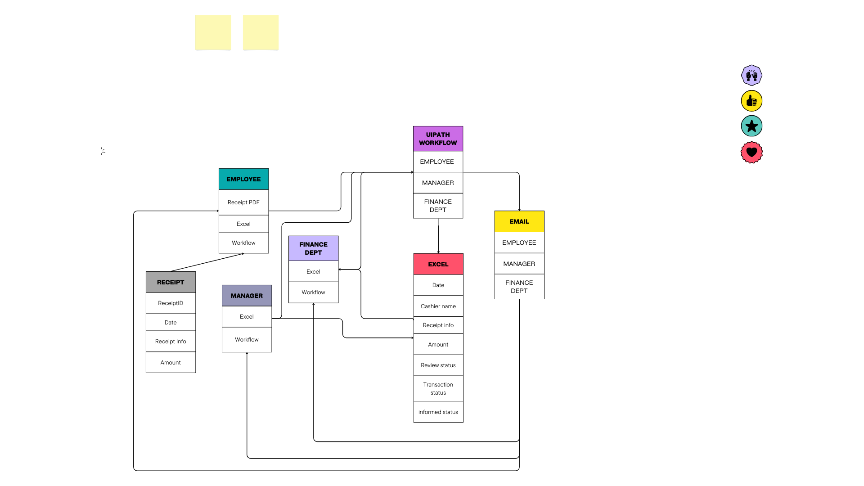
ERD

Slide 12
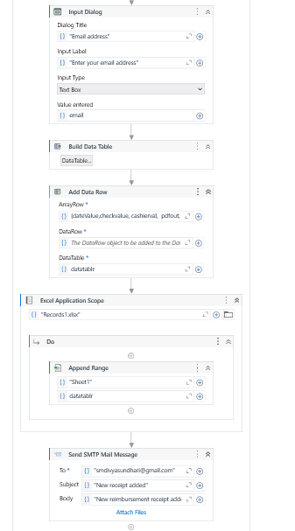
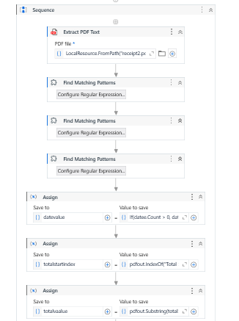
Implementation
Implementation of workflow 1

Slide 13
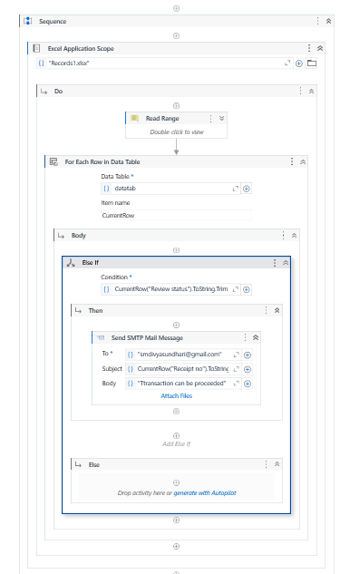
Implementation
Implementation of workflow 2

Slide 14
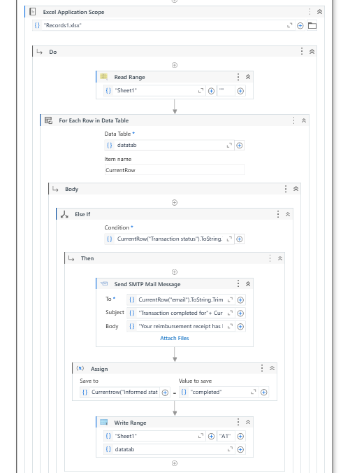
Implementation
Implementation of workflow 3

Slide 15
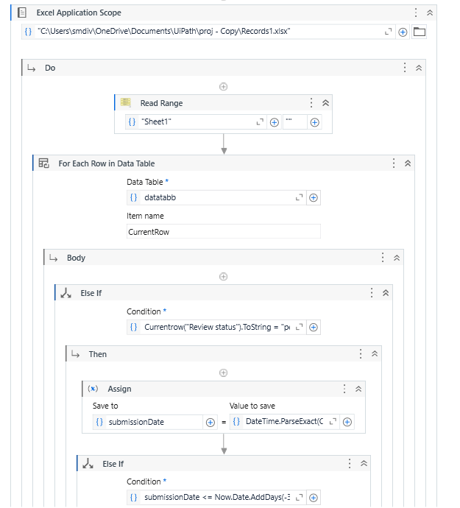
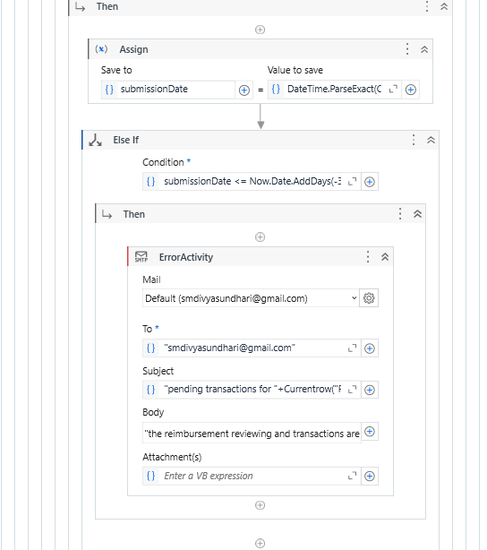
Implementation
Implementation of workflow 4

Slide 16
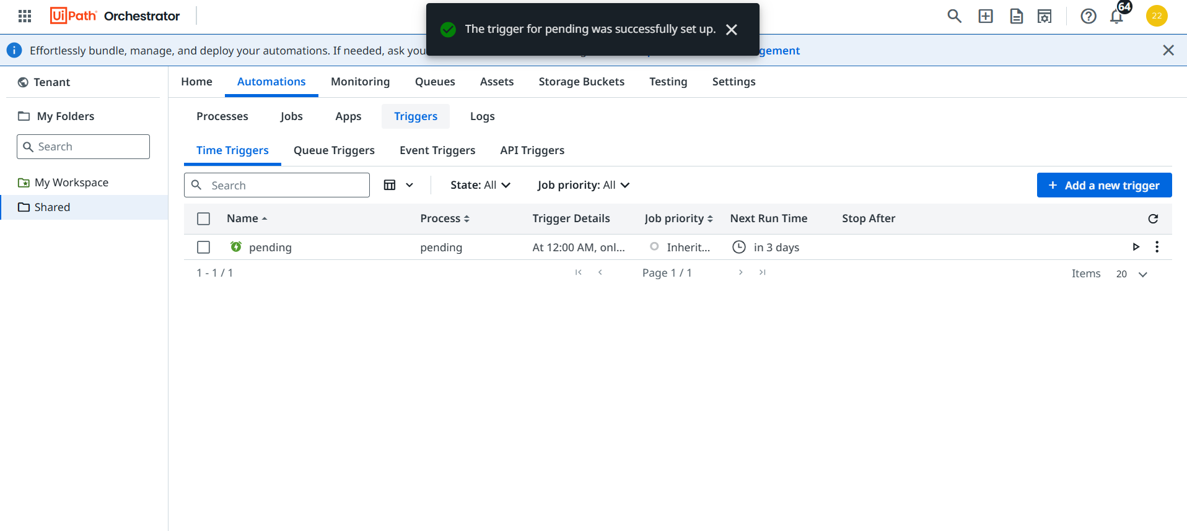
Orchestrator trigger creation

Slide 17
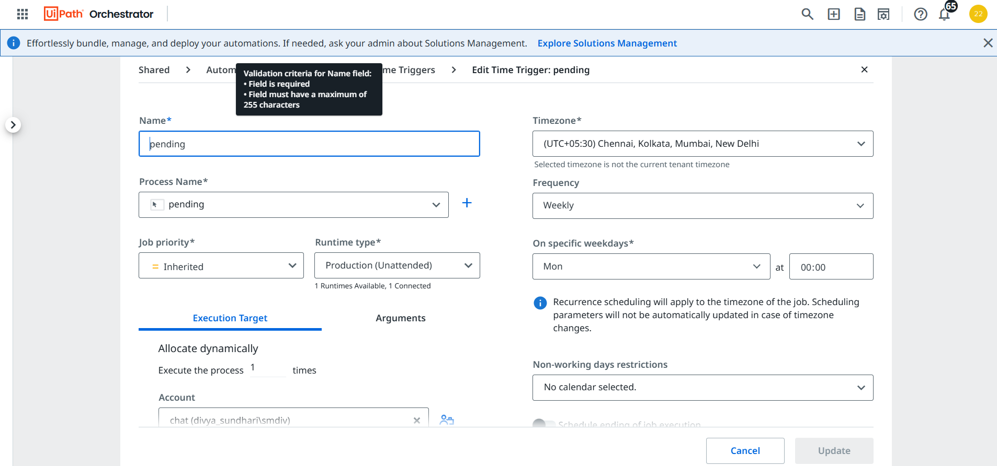

Slide 18
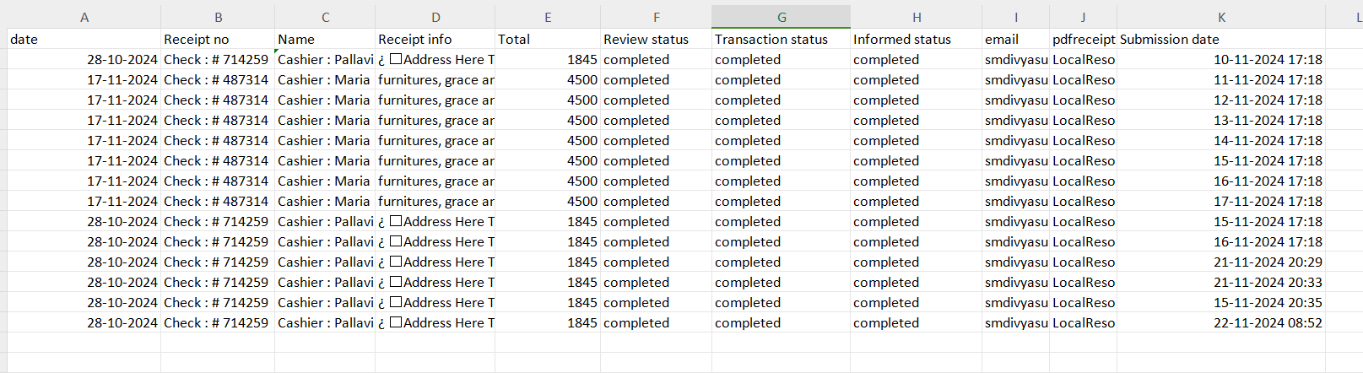
Excel sheet

Slide 19
Conclusions
In conclusion, this automated workflow effectively streamlines the expense reimbursement process by leveraging UiPath's capabilities to extract and process data from PDF documents, validate status conditions, and notify employees about the status of their reimbursement requests. By integrating Excel for data storage and SMTP for communication, the workflow ensures timely and accurate handling of expense submissions, minimizing manual effort and reducing the risk of errors. The automation not only improves efficiency but also enhances transparency and communication within the organization, allowing managers to focus on higher-priority tasks while ensuring employees are kept informed about the progress of their requests.

Slide 20
Future Enhancement
Adding advanced conditions using Regex to extract more detailed and diverse data from various types of expense receipts, enabling greater flexibility in processing multiple formats.
A feature can be implemented to allow employees to recheck or update their “Receipt info" if needed. In such cases, the automation can trigger an email notification to the employee, prompting them to verify or correct the details by manager.
Adding advanced reporting and analytics features could also help managers gain insights into spending trends and identify potential cost-saving opportunities. Furthermore, implementing more robust error handling and notifications could improve the workflow’s resilience, ensuring smooth operation even in the case of unexpected issues or missing data.

Slide 21
References
https://sciendo.com/pdf/10.2478/picbe-2024-0275
https://datafinity.co.za/wp-content/uploads/2021/02/RPA-for-HR_Creating-a-More-Human-Workplace.pdf
https://docs.uipath.com/

Slide 22
Thank You

